Slide 1

Healthcare project Story
Data & Product Analyst
Healthcare project

Slide 2

Healthcare data Analysis
Forcasting

Slide 3
Main Business Questions
✅ Billing & Cost Analysis
✅ Patient Demographics & Disease Trends
✅ Hospital Performance & Admissions Forecasting
✅ Doctor & Medication Effectiveness

Slide 4
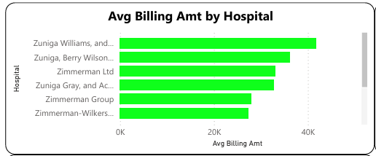
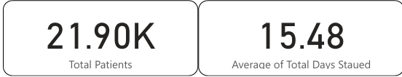

Slide 5
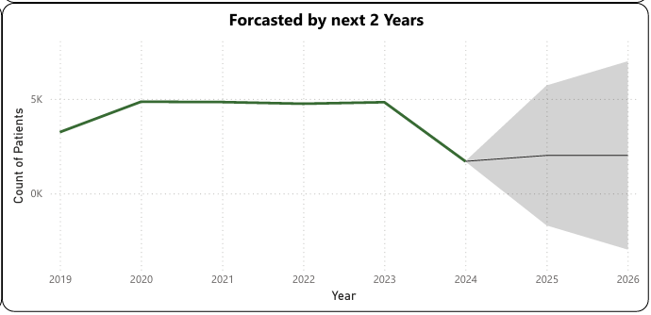
Forcasting

Slide 6
Top 5 Business Recommendations for the Stakeholder
🔹 1️⃣ Optimize Resource Allocation Based on Admission Trends
If admissions show seasonal peaks, ensure adequate staff, beds, and resources during high-demand periods.
Implement predictive scheduling for doctors & nurses to reduce wait times.
🔹 2️⃣ Control High Medical Costs & Billing Variations
Identify hospitals with higher-than-average billing amounts and analyze cost drivers.
Negotiate better rates with insurance providers or optimize hospital efficiency to reduce expenses.
🔹 3️⃣ Improve Patient Outcomes by Analyzing Doctor & Medication Effectiveness
Identify doctors with the best patient recovery rates and share best practices across hospitals.
Recommend effective medications based on recovery trends & reduce ineffective treatments.

Slide 7
🔹 4️⃣ Focus on High-Risk Patient Groups
If certain age groups or demographics are at higher risk for conditions (e.g., diabetes, obesity), launch preventive healthcare programs.
Partner with insurance companies to offer targeted wellness programs.
🔹 5️⃣ Enhance Insurance Coverage & Reduce Denials
If some insurance providers reject or underpay claims, initiate discussions to improve coverage.
Identify billing patterns leading to claim denials and improve documentation processes.
Note: Used Ai tools to leverage the work

Slide 8
Ramesh k
Data & Product Analyst
👩🏻‍💻 LinkedIn 🙋‍♀️ Portfolio

